Slide 1
Delaware General Assembly Joint Committee on Capital Improvement
President Dennis Assanis
March 24, 2023

Slide 2
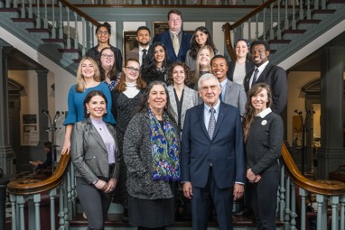
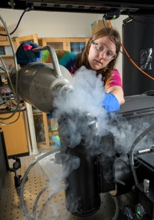
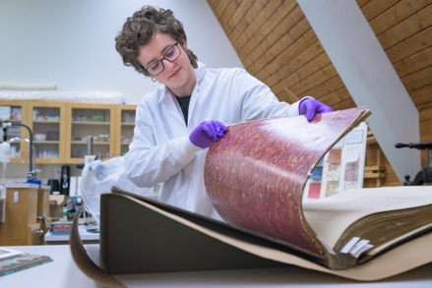
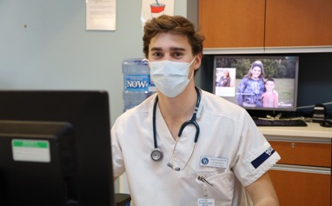
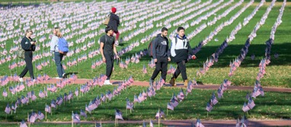
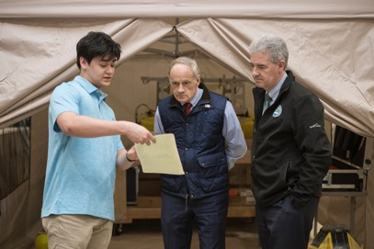
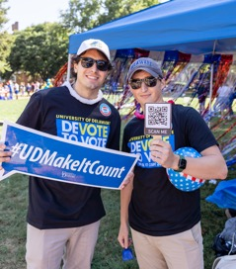
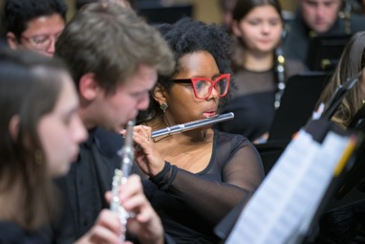
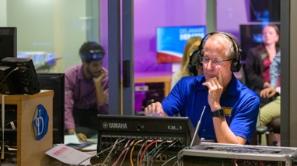
UD & the State:
Advancing Delaware’s Future
udel.edu/delawareimpact

Slide 3
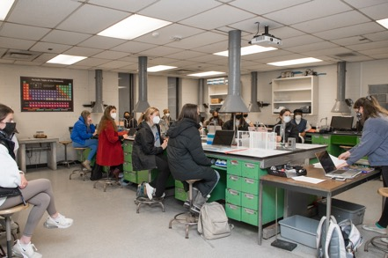
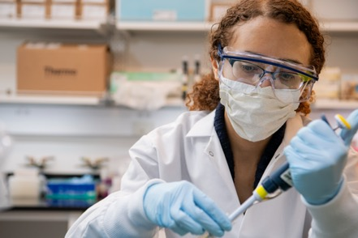
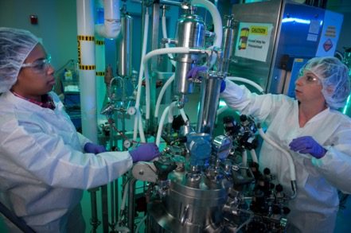
UD & the State: Advancing Delaware’s Future
EDUCATION
RESEARCH
ECONOMIC IMPACT
$30M for deferred maintenance in our academic facilities
$7M for the National Institute for Innovation in Manufacturing Biopharmaceuticals (NIIMBL)
$15M for the Securing American Biomanufacturing Research & Education (SABRE) Center

Slide 4
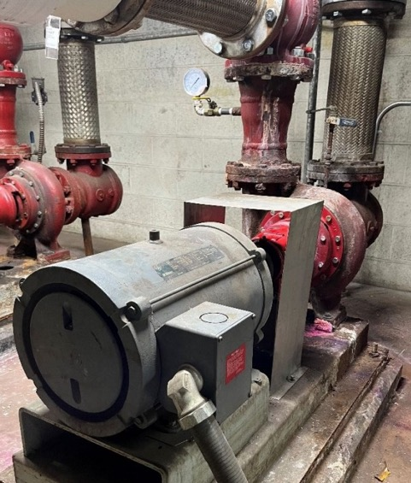
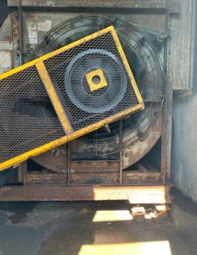
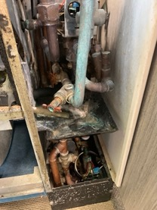
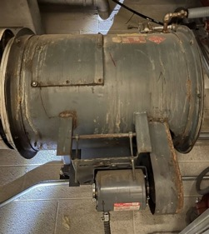
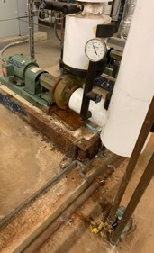
FY24 Request: $30M for deferred maintenance
(in millions)
GRB
Additional request

Slide 5
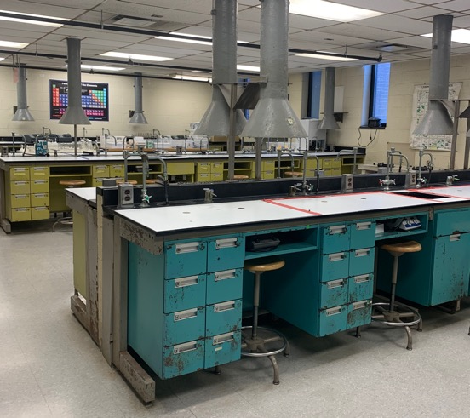
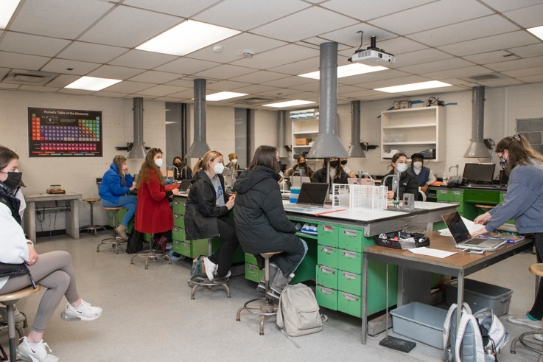
Drake Hall: Outdated labs in poor condition

Slide 6
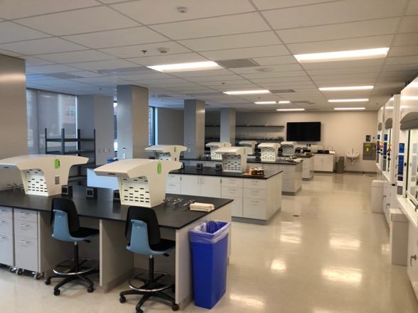
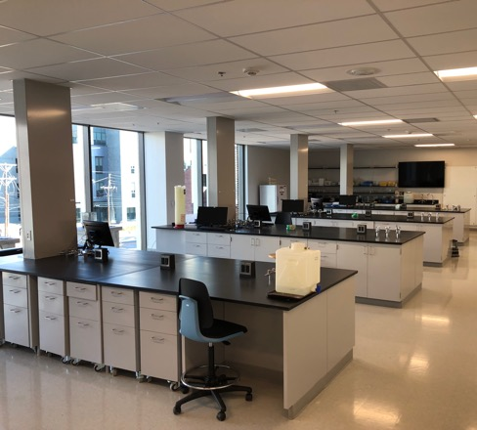
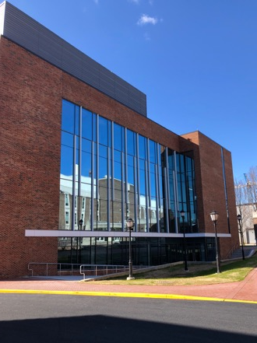
Drake Hall: Renovation & addition — Thank you!
Notes:
Renovation and addition of chemistry labs to accommodate more students in the STEM disciplines

Slide 7
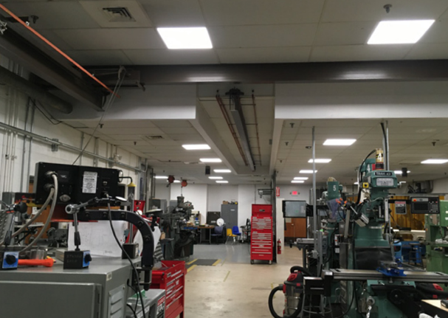
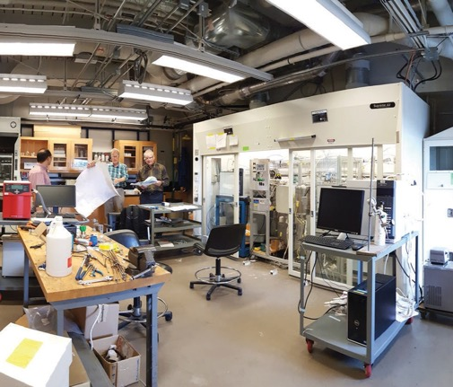
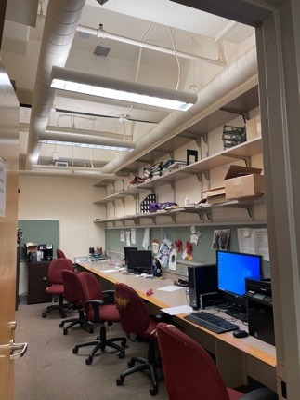
Meeting the need for modern academic facilities
Spencer Lab
Wolf Hall
Colburn Lab

Slide 8
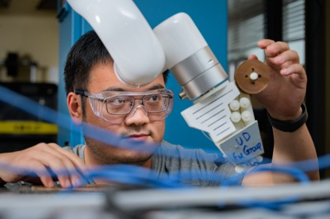
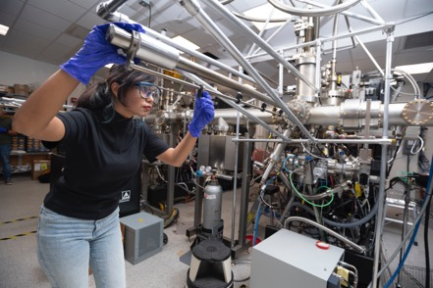
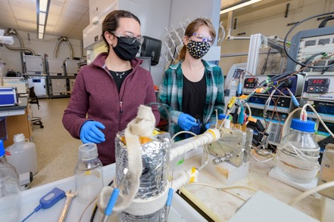
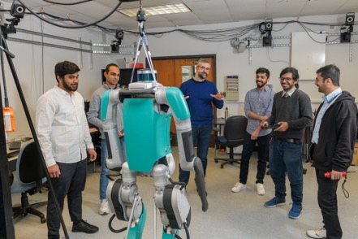
Educating tomorrow’s engineers for Delaware
Ranked
#2
Chemical Engineering (undergrad)
#1
In research spending for Chemical Engineering

Slide 9
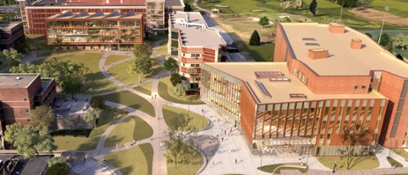
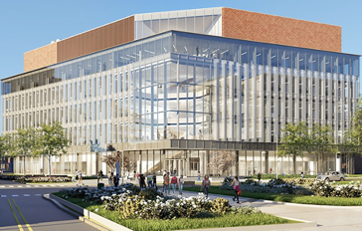
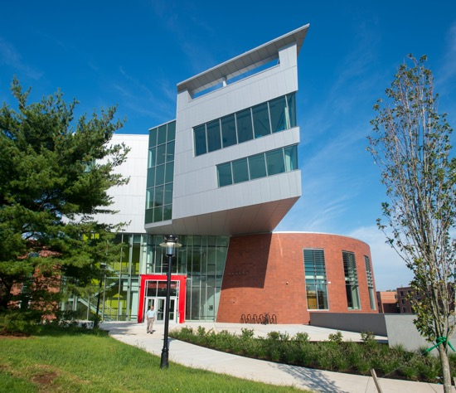
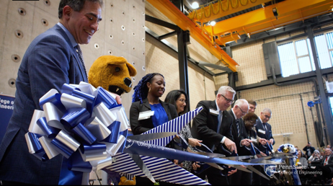
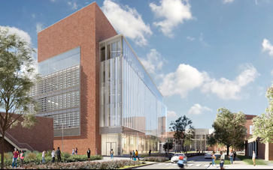
Maintaining our standing among competitors
Penn State University
University of Maryland
Rutgers University

Slide 10
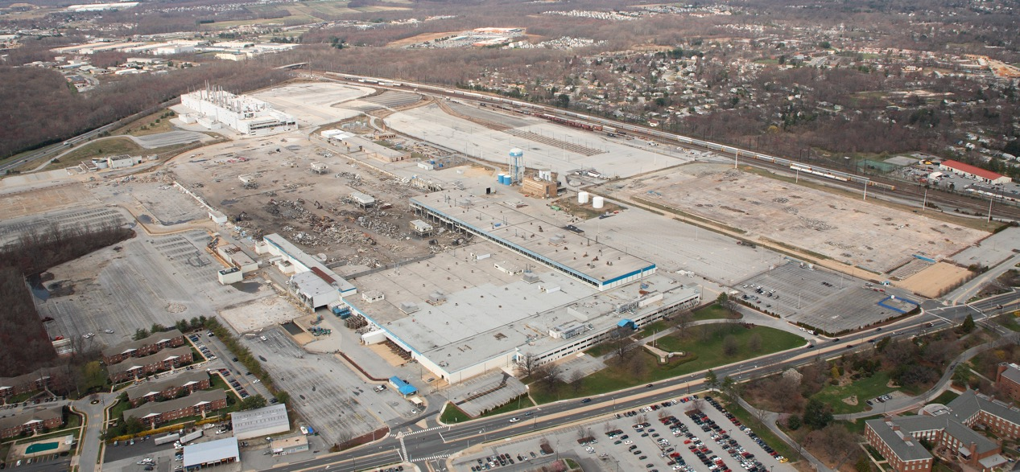
Developing STAR Campus as an innovation hub
Rt. 4
Water tower
Rail corridor
2011
South College Ave.
Notes:
Photo taken April 4, 2011

Slide 11
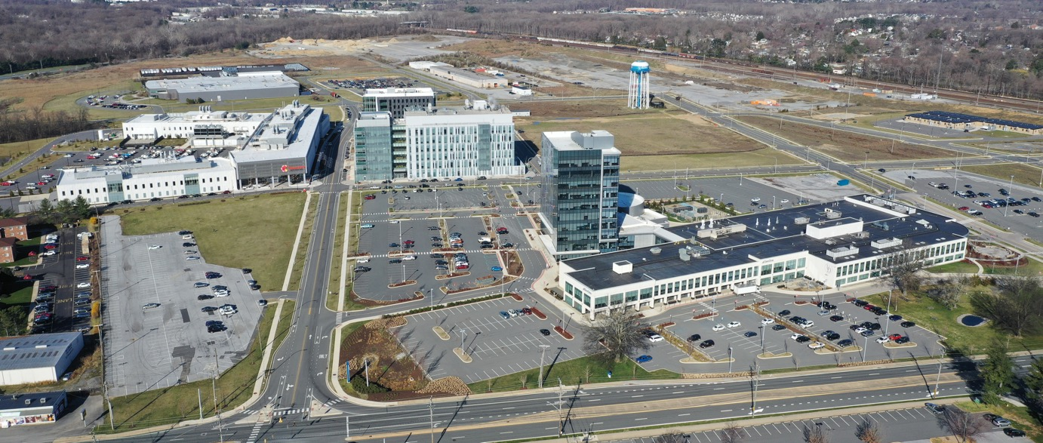
Developing STAR Campus as an innovation hub
Bloom
Energy
Fintech
Innovation Hub
Water tower
Rt. 4
Rail corridor
Chemours
Discovery Hub
The Tower at STAR
Ammon Pinizzotto
Biopharmaceutical
Innovation Center
Health Sciences Complex
Proposed
residential/retail
Today
South College Ave.

Slide 12
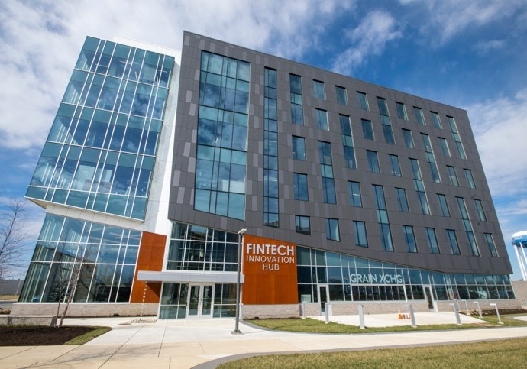
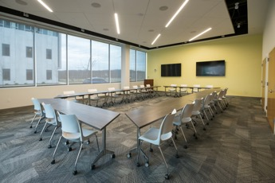
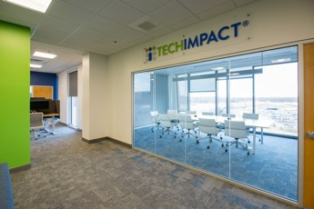
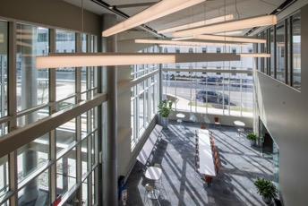
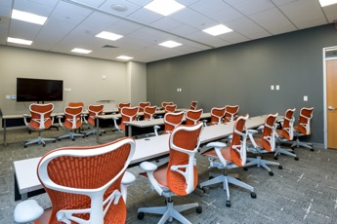
Fintech Innovation Hub nears opening at STAR
Notes:
Anticipated opening in summer 2023
Expand capacity for student and industry experiential learning and engagement
Support entrepreneurs, especially underrepresented minority leaders
Engage with financial service providers regarding their technology needs
Intensify collection, analysis and use of data and research to identify community needs
Grow the number/diversity of fintech workers in Delaware
Cultivate a P3 collaborative ecosystem
Attract global investment in fintech
Initial tenants
Discover Bank — largest consumer-only bank in US and leading fintech employer in Delaware
The Venture Center — East Coast hub of the nation’s #1 rated fintech accelerator
Financial Health Network — Nonprofit with a mission to improve financial literacy and health for all
Innovative Precision Health — Healthcare analytics company focused on optimizing continuum of care
Tech Impact — Nonprofit that leverages technology to advance social impact
Data Innovation Lab — Acquired by Tech Impact; focuses on complex big-data projects of all kinds
Kendal Corp. — Nonprofit serving older adults with housing, financial literacy and digital security; relocated its national headquarters at STAR
RAAD360 — Innovates in global supply chain functions and risk; has large government contracts and is a Microsoft partner; uses a lot of UD grad students as interns
Delaware BioScience Association — Nonprofit serving the life sciences sector in the state; 130 member companies with ~8,000 workers
The Grain Exchange — Craft bar and kitchen, founded by UD alumni; an essential element of making STAR a community of innovators

Slide 13
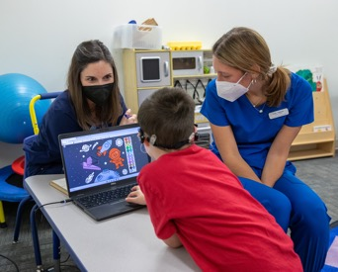
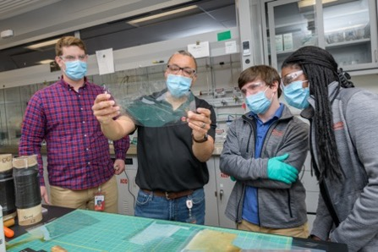
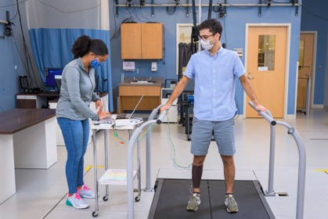
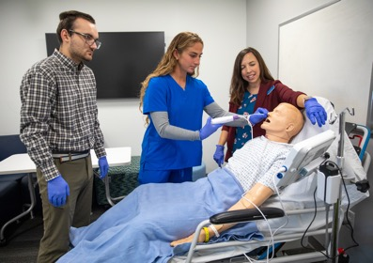
Building a nexus of learning, research and service
“There are more people working on the University of Delaware’s STAR Campus today than when Chrysler closed its manufacturing facility at the site in 2008. It’s hard to believe – but it says a heck of a lot about where our economy is headed. More than 3,000 people now work at the STAR Campus every day.”
— Gov. John Carney
State of the State Address, 2023

Slide 14
FY24 Request: $7M toward NIIMBL partnership
(in millions)
(in millions)
Federal
State*
Other partners
GRB
Additional request
Future requests
*Requested; includes FY23

Slide 15
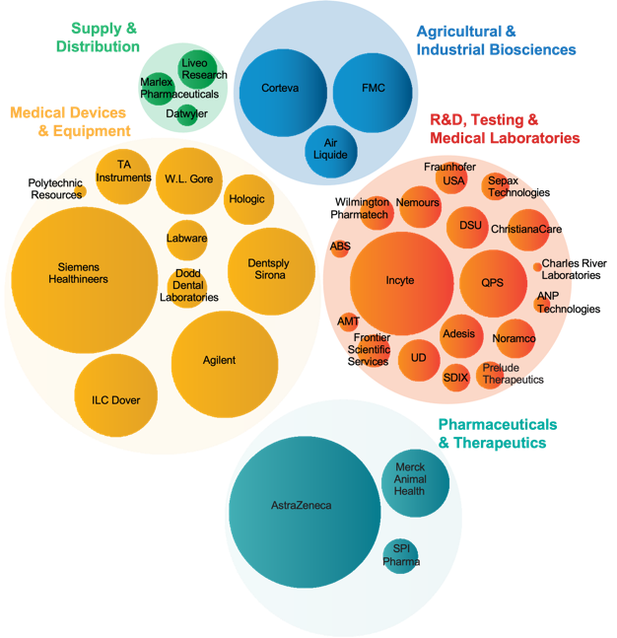
Investments build Delaware’s life sciences sector
1999 — DEDO recruits AstraZeneca’s US headquarters to Delaware
2001 — Delaware Biotechnology Institute created, providing access to core facilities, research & student talent
2006 — Delaware Biosciences Association created, now representing 160+ entities
2009 — UD purchases the Chrysler site and creates the STAR Campus
2017 — NIIMBL created, headquartered at UD
2023 — NIIMBL develops plans for cGMP facility at STAR Campus
Source: Delaware Prosperity Partnership

Slide 16
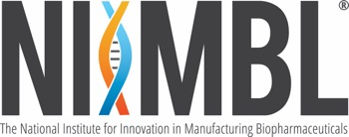
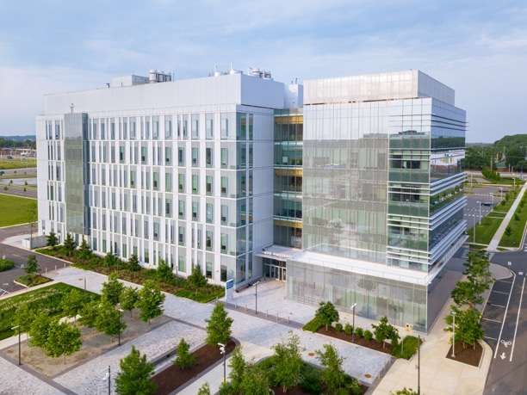
Building the bioeconomy for Delaware & the U.S.
Mission:
Accelerate biopharmaceutical innovation
Support development of standards that enable more efficient and rapid manufacturing capabilities
Educate and train a world-leading biopharmaceutical manufacturing workforce
Partners: 200+ in the public, private, nonprofit and academic sectors, including 22 in Delaware
Investment: $580M total by UD and partners
Ammon Pinizzotto Biopharmaceutical Innovation Center, headquarters of NIIMBL

Slide 17
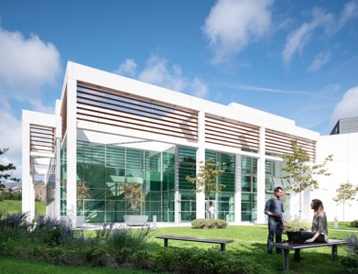
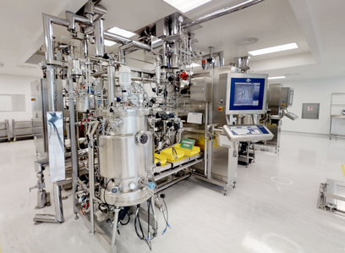
Training skilled workers in biomanufacturing
Securing American Biomanufacturing Research & Education (SABRE) Center
90,000 sq. ft.
Train workers in current Good Manufacturing Practices (cGMP)
Provide testing and production facilities
Ireland
Ireland
North Carolina
North Carolina

Slide 18
FY24 Request: $15M for the SABRE Center
(in millions)
(in millions)
NSF
State (requested)
UD (plus ongoing operating costs)
NIIMBL partners

Slide 20
Helping municipalities access federal funds
Some examples:
Milford and Slaughter Beach
Pedestrian multi-use pathway along Route 36
South Bethany and Bowers Beach Resiliency projects to offset the impacts of climate change

Slide 21
UD & the State: Advancing Delaware’s Future
EDUCATION
RESEARCH
ECONOMIC IMPACT
$30M for deferred maintenance in our academic facilities
$7M for the National Institute for Innovation in Manufacturing Biopharmaceuticals (NIIMBL)
$15M for the Securing American Biomanufacturing Research & Education (SABRE) Center

Slide 22
Delaware General Assembly Joint Committee on Capital Improvement
President Dennis Assanis
March 24, 2023

